Slide 1


Slocalization Sub-µW Ultra Wideband Backscatter Localization
Pat Pannuto, Benjamin Kempke, and Prabal Dutta
IPSN’18
April 13, 2018, Porto, Portugal

Slide 2
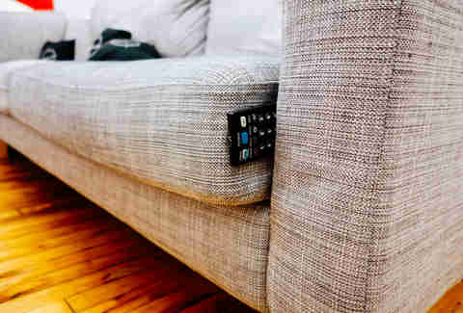
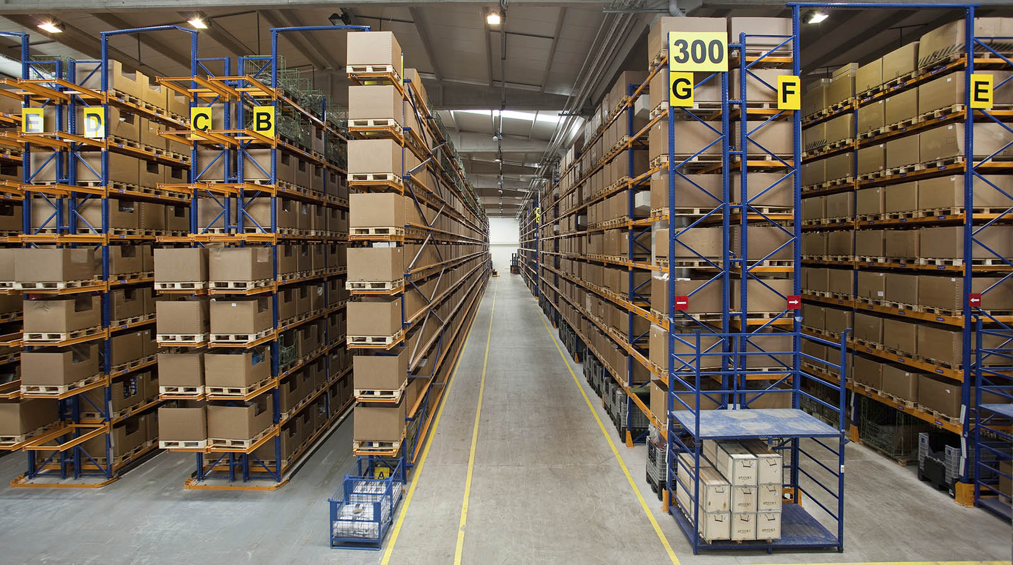

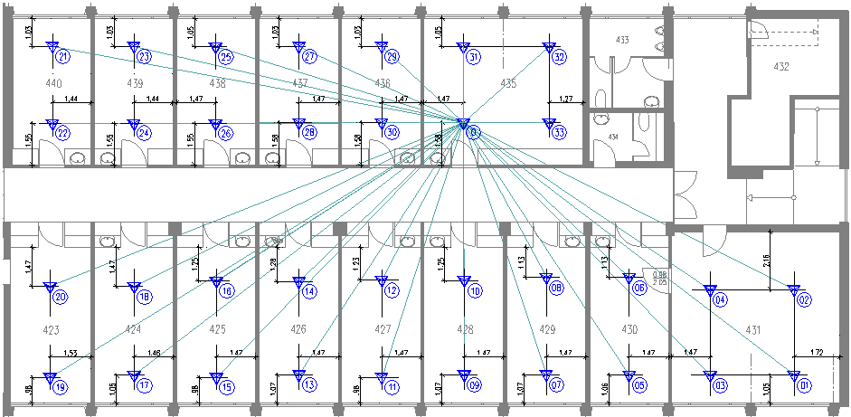
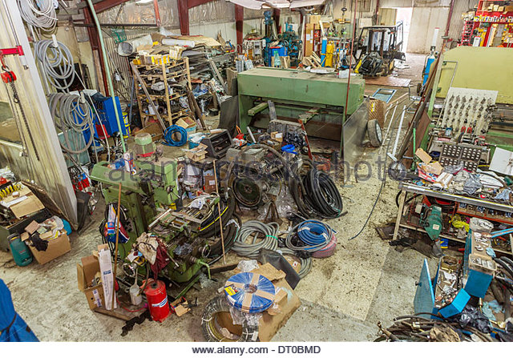
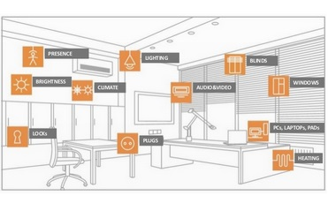
Let’s think bigger about localization: Can we locate every physical thing?
Can we make location a piece of first-class
context, available to every device?

Slide 3
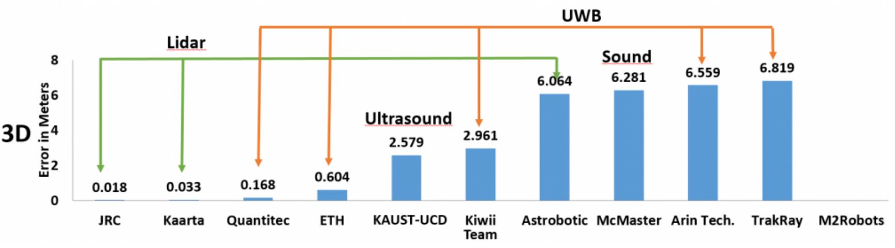
Ultra Wideband affords extremely high-fidelity localization
2015
UWB-Based
2016
2017

Slide 4
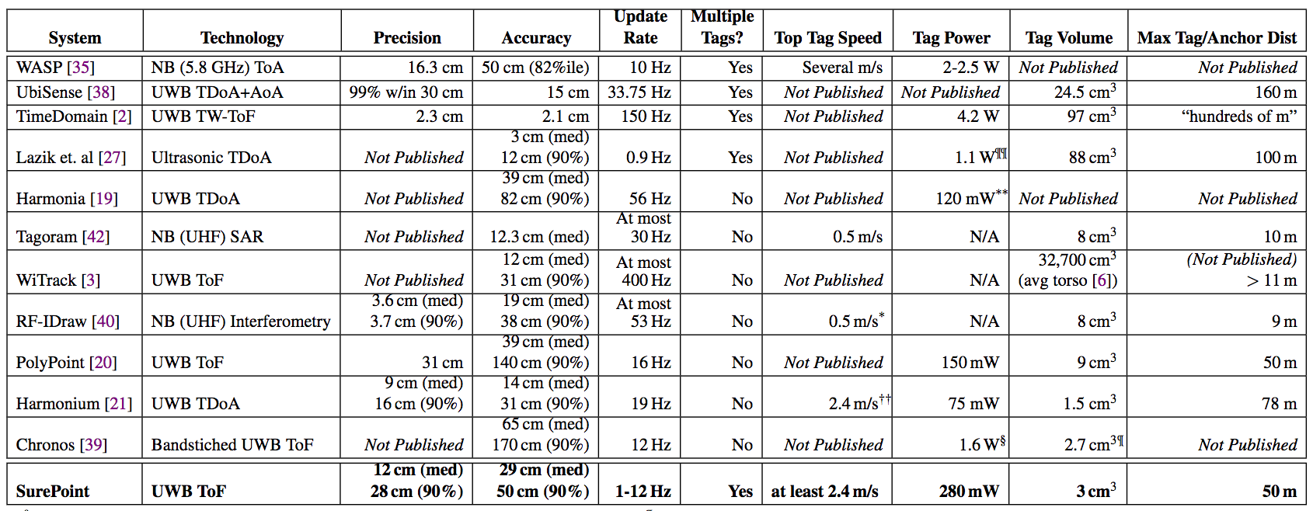
Ultra Wideband Radios (or impulse generators) are energy-hungry
Lowest power UWB is 75 mW
Table from: SurePoint: Exploiting Ultra Wideband Flooding and Diversity to Provide Robust, Scalable, High-Fidelity Indoor Localization. Benjamin Kempke, Pat Pannuto, Bradford Campbell, and Prabal Dutta. SenSys’16.

Slide 5
Backscatter renaissance is redefining low-power for wireless
Wireless communication from W/mW to µW/nW
Zhang, Pengyu, Jeremy Gummeson, and Deepak Ganesan. "Blink: A high throughput link layer for backscatter communication.” MobiSys’12
Kellogg, Bryce, Aaron Parks, Shyamnath Gollakota, Joshua R. Smith, and David Wetherall. "Wi-Fi backscatter: Internet connectivity for RF-powered devices.” SIGCOMM’14
Zhang, Pengyu, Pan Hu, Vijay Pasikanti, and Deepak Ganesan. "Ekhonet: High speed ultra low-power backscatter for next generation sensors.” MobiCom’14
Zhang, Pengyu, Dinesh Bharadia, Kiran Joshi, and Sachin Katti. "Hitchhike: Practical backscatter using commodity wifi.” SenSys’16
Ma, Yunfei, Nicholas Selby, and Fadel Adib. "Minding the billions: Ultra-wideband localization for deployed RFID tags.” MobiCom’17
Varshney, Ambuj, Oliver Harms, Carlos-Perez Penichet, Christian Rohner, Frederik Hermans, and Thiemo Voigt. "LoRea: A Backscatter architecture that achieves a long communication range.” SenSys’17
Carlos Pérez Penichet, Claro Noda, Ambuj Varshney, Thiemo Voigt. “Battery-Free 802.15.4 Receiver” IPSN’18

Slide 6
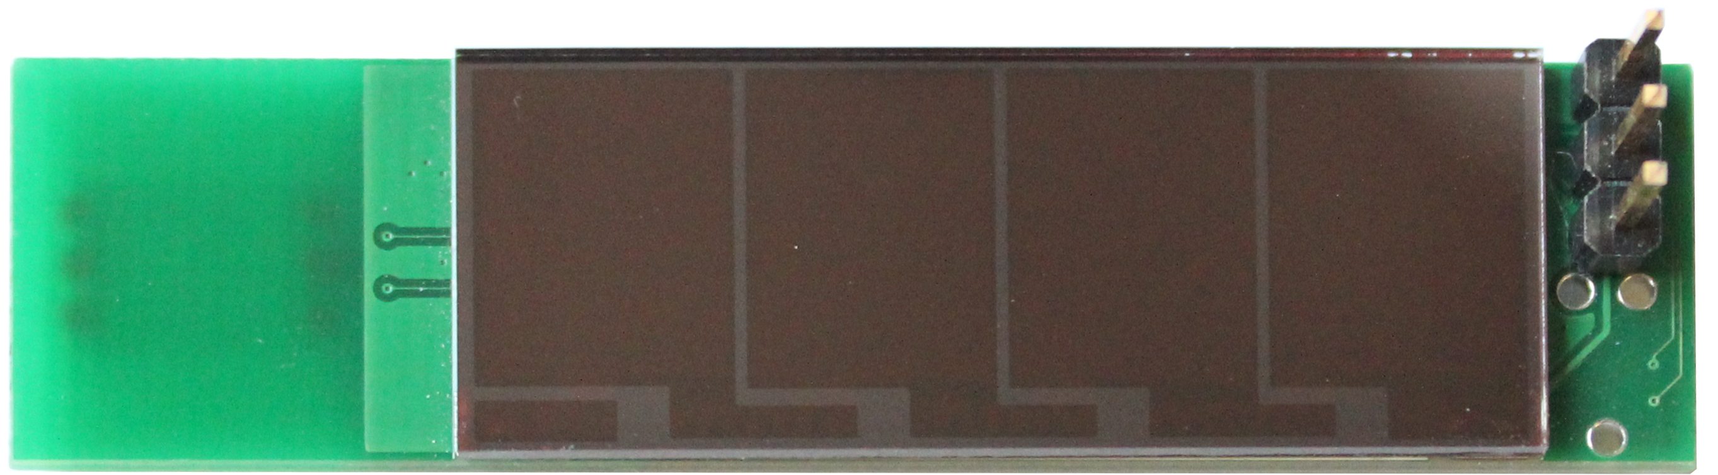
Slocalization: Ultra wideband backscatter whole-room localization for <1 µW
30 m

Slide 7
There has to be a catch…. There is a new tradeoff to introduce
<1 µW tag
(COTS, can do order of magnitude or more better with VLSI)
Covers areas 30m+
Decimeter accurate
(Nearly) unlimited number of concurrent tags
1-15+ minutes per location fix
Introducing the latency/energy tradeoff for localization

Slide 8
Can we locate every physical thing? Most things don’t move!
Location is fundamental to contextual relationships
Little is more basic to human perception than physical juxtaposition, and so ubiquitous computers must know where they are
Mark Weiser, The Computer for the 21st Century
Towards “search not file” for the physical world
Notes:
We have done a ton of work in localization technologies for the things that do move
- Can be most interesting
This work looks at the other 99% of things in the world
- Provide context around which things are moving

Slide 9
Outline
Most things don’t move
Building blocks of Slocalization
UWB localization
Backscatter
Putting them together
Does it actually work?
What comes next

Slide 10
Outline
Most things don’t move
Building blocks of Slocalization
UWB localization
UWB backscatter
Putting them together
Does it actually work?
What comes next

Slide 11
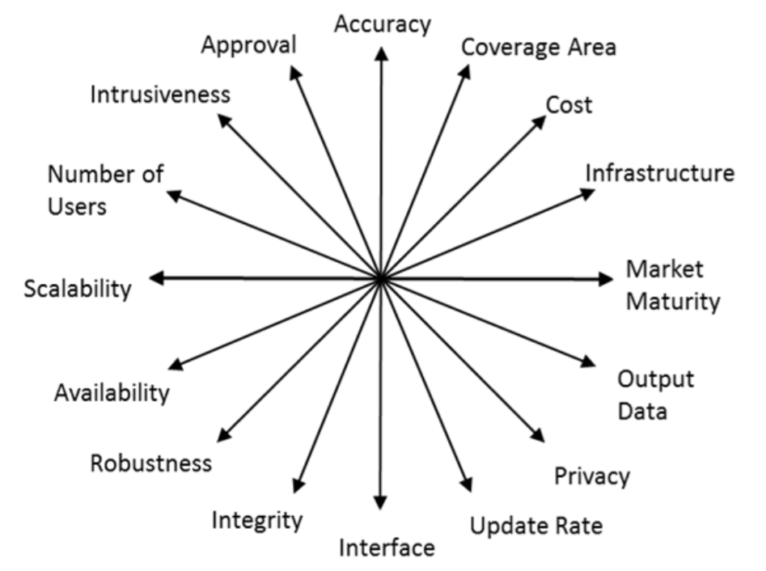
Why RF, why UWB for ubiquitous localization?
Narrowband
Ultra-Wideband
Mautz, Rainer. "Indoor positioning technologies." (2012).
Notes:
DEPLOYABILITY
RF “sees through walls”, “through furniture”, “in desk drawer”

Slide 12
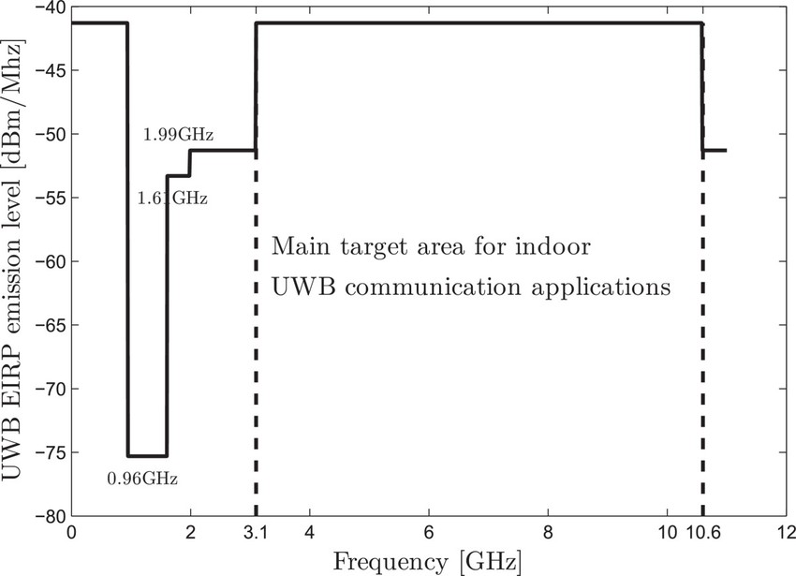
UWB can transmit 54 million times less power than traditional narrowband devices
3-10 GHz UWB → -41.3 dBm
900 MHz ISM → 36 dBm
900 MHz unlicensed
Control → -13.3 dBm
Periodic → -21.2 dBm
Vijaya Yajnanarayana. "Spectral efficient IR-UWB communication design for low complexity transceivers" (2014).
Notes:
https://www.wolframalpha.com/input/?i=10*log10+(x)+%3D+36+%2B+41.3

Slide 13
UWB Backscatter is passive reflection of a lot less energy
Sender
Receiver
Reflector

Slide 14
UWB Backscatter is passive reflection of a lot less energy
Sender
Reflector
Receiver
-100 dBm
-101 dBm
5m
5m
-41.3 dBm
-159 dBm
36 dBm
-56 dBm
900 MHz ISM
-9.5 dBm
-10.5 dBm
Notes:
NB: 900 Mhz -> wavelength = 299792458 / 900e6 = 0.33
20 * log10(.33 / (4 * pi * 5)) = -45.6
Over 100 dB (or over 1 billion times more power)

Slide 15
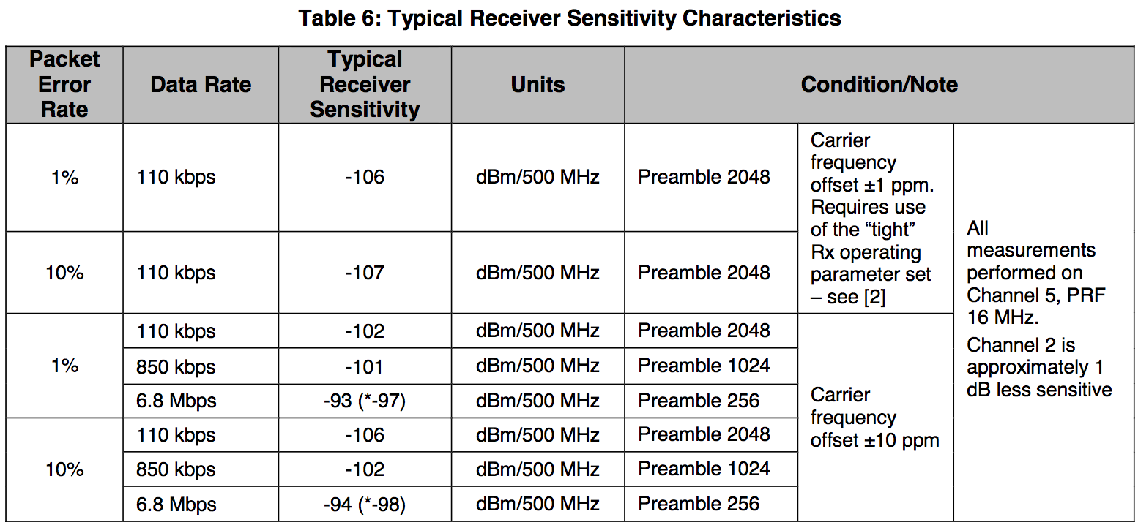
UWB Backscatter is passive reflection of a lot less energy
-100 dB
-101 dB
5m
5m
Typical receiver sensitivity
ranges from -94 to -106
-41.3 dB
-159 dBm
36 dB
-9.5 dB
-10.5 dB
-56 dBm
900 MHz ISM
Notes:
NB: 900 Mhz -> wavelength = 299792458 / 900e6 = 0.33
20 * log10(.33 / (4 * pi * 5)) = -45.6
Just 60 dB, only a million times off!

Slide 16
How do we recover a signal that is way below the noise floor?
Exploit tag stationarity and environmental stability
A
A
Notes:
Environment does not change

Slide 17
How do we recover a signal that is way below the noise floor?
Exploit tag stationarity and environmental stability
A
A

Slide 18
Ideally, the only change in the channel impulse response is the tag reflection
Subtracting the environment finds the tag

Slide 19
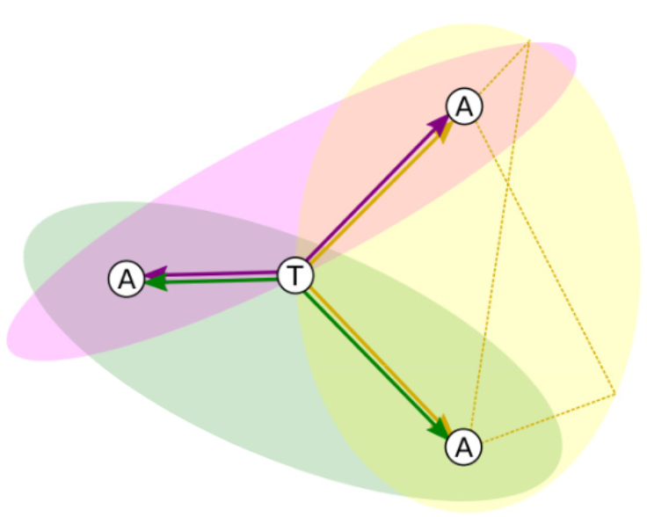
The goal is to estimate the time difference of arrival (TDoA) and laterate
First peak is anchor—anchor path, then anchor—tag—anchor

Slide 20
Extracting the tag signal in the real world has a few additional challenges
The environment is not actually static
But noise is largely white & Gaussian
And we can filter out the rest
When to add and when to subtract?

Slide 21
If you know what the tag is doing, then you know when to add or subtract
Reflective
Absorptive

Slide 22
Extracting the tag signal in the real world has a few additional challenges
The environment is not actually static
But noise is largely white & Gaussian
And we can filter out the rest
When to add and when to subtract?
Problem: Need to know when the tag is reflecting or absorbing
Solution: Guess and brute force search
Tag stability limits Slocalization range
More details in the paper…

Slide 23
DW1000 Receiver Sensitivity
Notes:
https://www.decawave.com/sites/default/files/resources/dw1000-datasheet-v2.09.pdf

Slide 24
Outline
Most things don’t move
Building blocks of Slocalization
UWB localization
Backscatter
Putting them together
Does it actually work?
What comes next

Slide 25
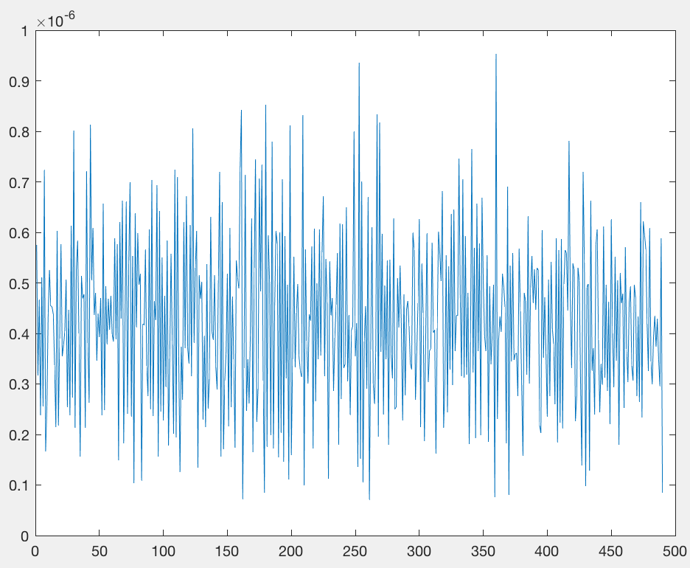
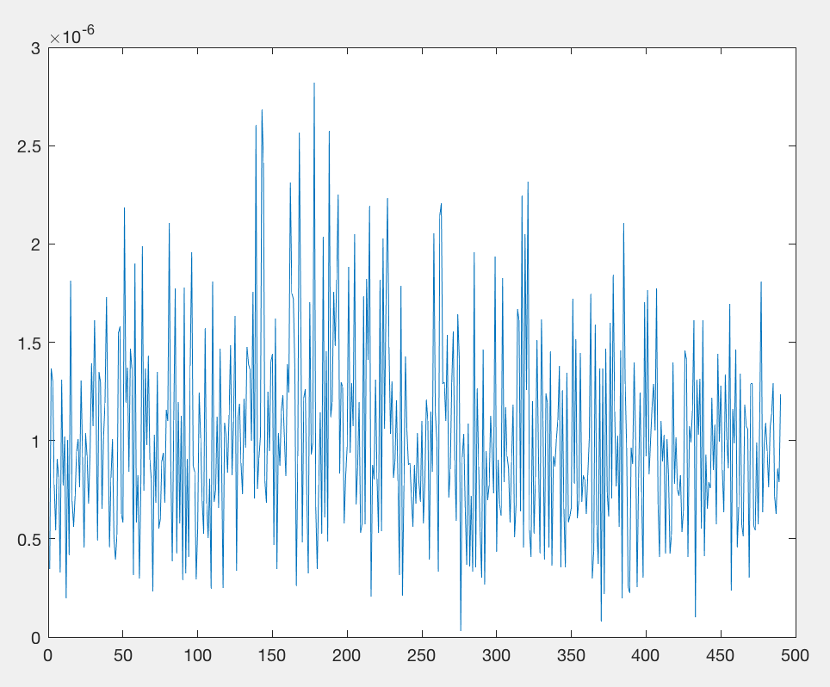
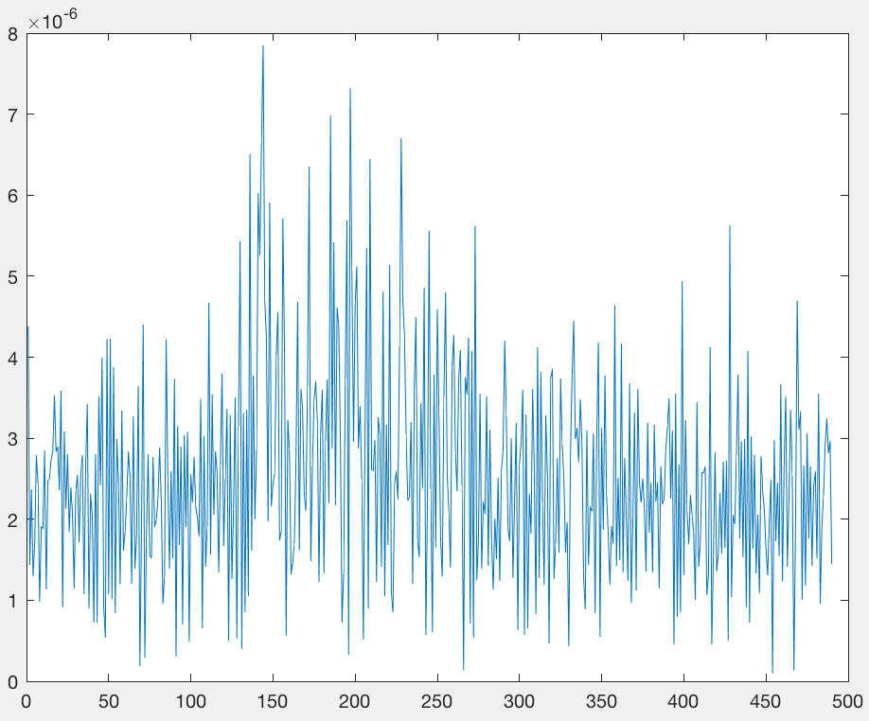
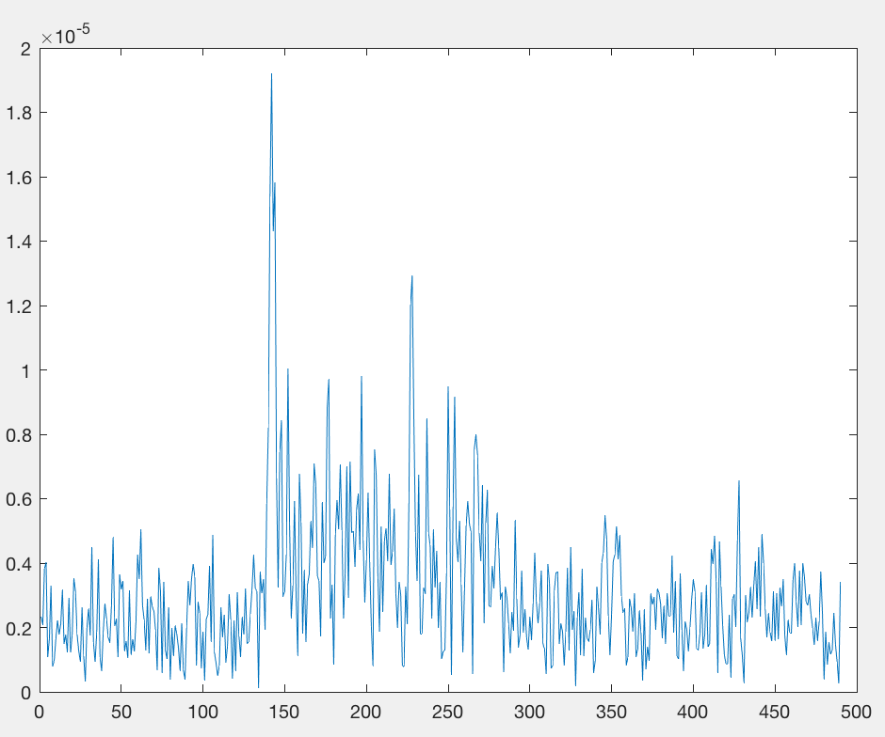
Recovery of modulated signal improves with greater integration time
R₁ = 6 m, R₂ = 24 m
6 seconds
50 seconds
250 seconds
500 seconds
(8.3 minutes)
Notes:
125 ms -> 6.2 s
1 s -> 49 s
5 s -> 245 s
10 s -> 490 s
256 Hz, no PN, 30m, 06m pos

Slide 26
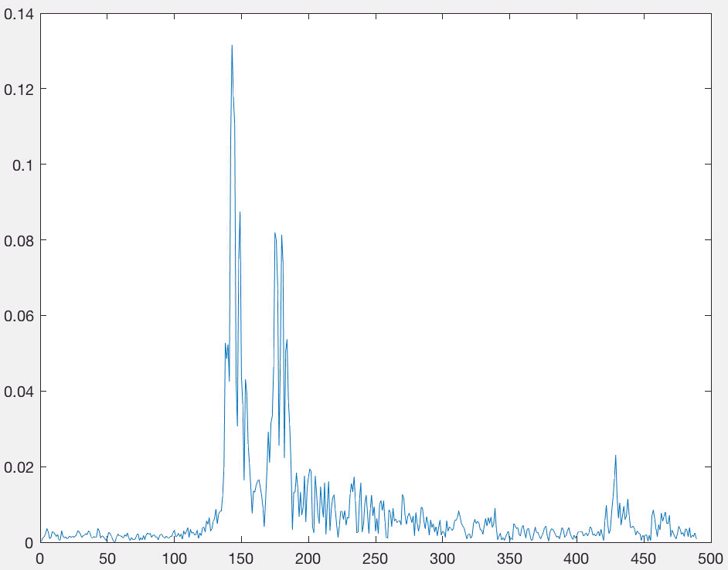
Recovery of modulated signal improves with greater integration time
R₁ = 6 m, R₂ = 24 m
6 seconds
Raw Channel Impulse Response
Correlated Channel Impulse Response
Notes:
125 ms -> 6.2 s
1 s -> 49 s
5 s -> 245 s
10 s -> 490 s
256 Hz, no PN, 30m, 06m pos

Slide 27
Recovery of modulated signal improves with greater integration time
R₁ = 6 m, R₂ = 24 m
50 seconds
Raw Channel Impulse Response
Correlated Channel Impulse Response
Notes:
125 ms -> 6.2 s
1 s -> 49 s
5 s -> 245 s
10 s -> 490 s
256 Hz, no PN, 30m, 06m pos

Slide 28
Recovery of modulated signal improves with greater integration time
R₁ = 6 m, R₂ = 24 m
250 seconds
Raw Channel Impulse Response
Correlated Channel Impulse Response
Notes:
125 ms -> 6.2 s
1 s -> 49 s
5 s -> 245 s
10 s -> 490 s
256 Hz, no PN, 30m, 06m pos

Slide 29
Recovery of modulated signal improves with greater integration time
R₁ = 6 m, R₂ = 24 m
500 seconds
(8.3 minutes)
Raw Channel Impulse Response
Correlated Channel Impulse Response
Notes:
125 ms -> 6.2 s
1 s -> 49 s
5 s -> 245 s
10 s -> 490 s
256 Hz, no PN, 30m, 06m pos

Slide 30
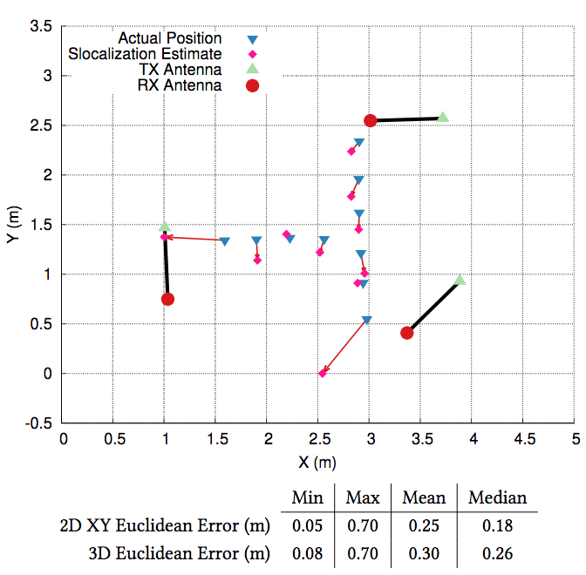
Can we localize?
Yes!

Slide 31
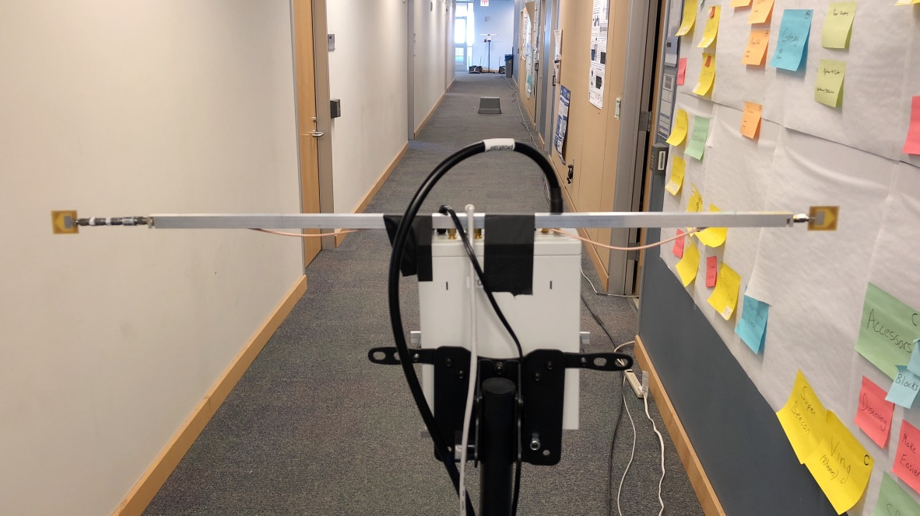
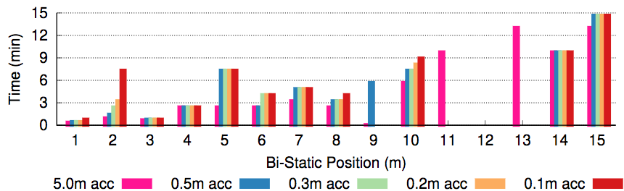
Can we really cover whole rooms?
15 minutes can cover 30 meters
15m
15m

Slide 32
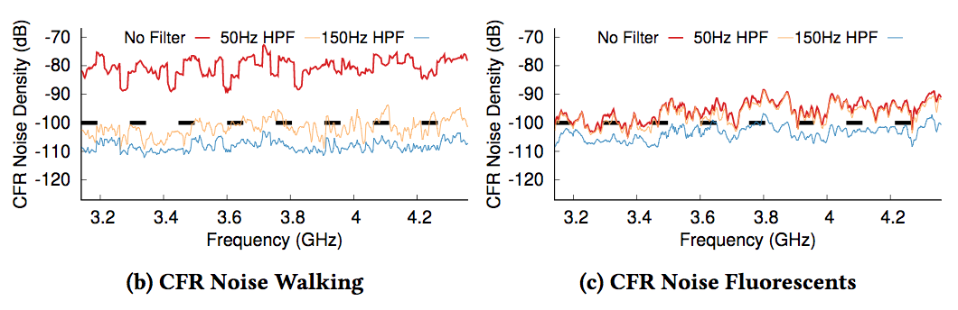
Environmental Factors?
Most environment noise is < 150Hz, filter
Sets floor for tag frequency (and in turn active power)
Problem: A fan at a bad speed is a bad day for slocalization

Slide 33
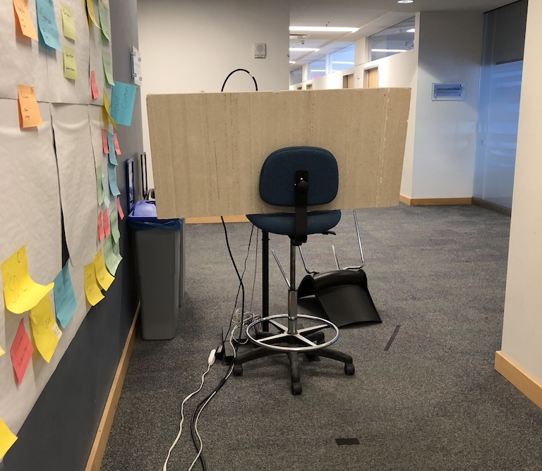
NLOS?

Slide 34
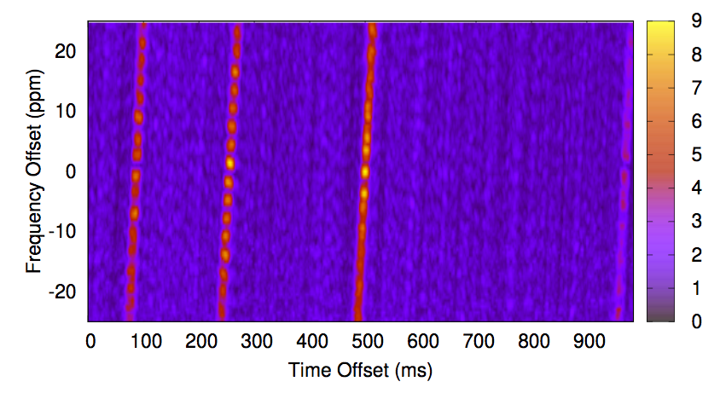
Does it scale to multiple tags?
Can use PN codes for concurrent tags
… But processing is expensive

Slide 35
Outline
Most things don’t move
Building blocks of Slocalization
UWB localization
Backscatter
Putting them together
Does it actually work?
What comes next

Slide 36
Numerous diversity sources allows Slocalization to scale to very many tags
Frequency division scales linearly in frequencies
Caveat: 256.00 Hz low-power RTCs exist, less so 256.20 Hz, etc
Caveat: Power draw scales linearly with switching frequency
PN codes scale linearly in tag length
Temporal code rotation scales factorially, but is very slow
Idea: Exploit tag stationarity further, rotating PN codes over time
$$f_{STEPS}∗{PN}_{bits}∗Codes=1,280 ∗63 ∗4!=1,935,360 concurrent tags$$
in roughly a few hours
Feasibility?
Power?
Time
Time

Slide 37
Broadcast ranging enables efficient scaling to improve accuracy and reliability
A
A
A

Slide 38
Broadcast ranging enables efficient scaling to improve accuracy and reliability
A
A
A
A

Slide 39
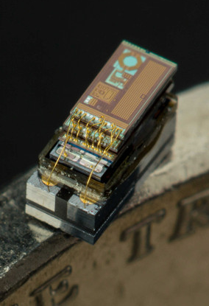
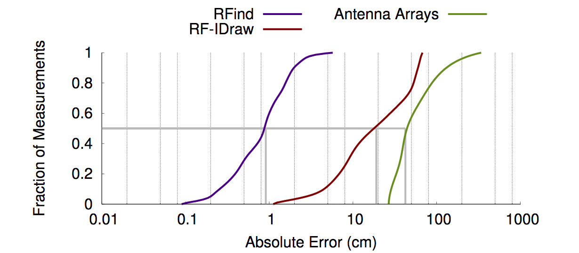
Can we localize every physical thing? Even dust?
Super-resolution technique from MobiCom’17
Use frequency information to refine localization
Key idea:
If traditional localization can get close (7cm), refine estimate based on the estimate from each frequency
Minding the Billions..., Ma, Selby, Adib. MobiCom’17

Slide 40

Slocalization: Sub-µW Ultra Wideband Backscatter Localization
Decimeter accurate, FCC-compliant, sub-µW localization
Ultra wideband backscatter platform
Ultra wideband backscatter recovery from below noise floor
Demonstrated over 30m anchor-tag-anchor in LoS & NLoS
Designs, firmware, processing, etc:
github.com/lab11/slocalization
patpannuto.com @patpannuto

